Slide 1
Internet of Things essentials presentation
WATER FLOW RATE AND OVERFLOW DETECTION
SUDHARSAN SAKTHI D (210701267)
TARUN KUMAR S (210701286)

Slide 2
AGENDA
I. ABSTRACT
II. INTRODUCTION
III. OBJECTIVE
IV. LITERATURE SURVEY
a. KEY CHALLENGES
b. MOTIVATION
V. EXISTING SYSTEM
VI. PROPOSED SYSTEM
VII.MODULES
VIII. SYSTEM ARCHITECTURE
IX. CONCLUSION AND FUTURE ENHANCEMENTS
X. REFERENCES

Slide 3
ABSTRACT
For human life and the health of the environment, water is important. We have created an automated water quality management system for home, workplaces, etc. in order to achieve the good water quality needed by the citizens through IoT. We have used different sensors to design a device to calculate the water pH, the water pressure, flow,etc. we have recommended the use of a smart interface sensor to track water reservoirs and monitor leakages from water pipelines. The the water leak detector in the pipelines are used to monitor water quality. They use the ultrasonic sensor for tests. The automation of the system is demonstrated by arduino. The device is powered by laptop. With this device installed in smart buildings, we can collect and evaluate the residents 'water usage habits and save a lot of water from waste.

Slide 4
INTRODUCTION
Effective water management is crucial for sustainable development, especially amid urbanization and climate change. This project aims to develop an advanced system for real-time monitoring of water flow rates and overflow detection. Utilizing high-precision flow sensors, machine learning, and predictive analytics, the system provides accurate data to optimize water distribution and prevent waste. Continuous data transmission and real-time analysis enable proactive maintenance, reducing overflow risks. Scalable and user-friendly, the system is suitable for residential to municipal applications, enhancing water resource management and promoting sustainable use.

Slide 5
OBJECTIVE
⠂Develop a Comprehensive Monitoring System: Design and implement an integrated system capable of continuously monitoring water flow rates across various points in a water distribution network.
⠂Utilize Advanced Sensor Technology: Deploy high-precision flow sensors to ensure accurate and reliable measurement of water flow rates in different environments, including residential, commercial, and industrial settings.
⠂Implement Real-Time Data Transmission:Establish a robust data transmission framework that leverages wireless communication technologies to facilitate the real-time transfer of flow data from sensors to a central processing unit.
⠂Analyze Data with Machine Learning Algorithms: Develop and train machine learning models to analyze collected data, detect anomalies, and predict potential overflow events based on historical and real-time data.

Slide 6
LITERATURE SURVEY
S.NO | AUTHOR(S) | YEAR OF PUBLISHING | TITLE | DESCRIPTION
1. | R. K. Gupta, S. Sharma | 2016 | Smart Water Flow Monitoring and Overflow Detection System | This study presents an innovative system utilizing IoT for monitoring water flow rates and detecting overflows. .
2. | J. Smith, L. Brown | 2022 | Real-Time Water Flow Monitoring Using Sensor Networks | The deployment of sensor networks for continuous monitoring of water flow in distribution systems. The paper details the architecture of the sensor network, data collection methodologies to Prevent overflow

Slide 7
LITERATURE SURVEY
3. | Jakubowski K | 2020 | Predictive Analytics for Water Overflow Prevention | This research focuses on the application of predictive analytics to forecast potential overflow scenarios . The authors develop a model based on historical flow data, weather conditions, and usage patterns to predict overflow events.
4. | Zhou, K., Zhang, X. | 2020 | Advanced Sensor Technology for Water Management | The role of advanced sensor technology in water flow rate monitoring and overflow detection. The paper describes the deployment of high-precision flow metersin control systems

Slide 8
LITERATURE SURVEY
5. | P. Zhang, H. Wu | 2021 | Machine Learning Techniques for Water Overflow Detection | Zhang and Wu examine the use of machine learning techniques to enhance the detection of overflows in water distribution systems. The research introduces neural networks and support vector machines
6. | S. Chen, T. Nguyen | 2020 | IoT-Based Water Flow and Overflow Monitoring System | Chen and Nguyen present an IoT-based system designed for real-time monitoring of water flow rates and early detection of overflows. The system incorporates a flow sensor.

Slide 9
LITERATURE SURVEY
7. | R. Martin, D. Clark | 2023 | Integrating AI for Enhanced Water Flow and Overflow Detection | the integration of artificial intelligence (AI) in water flow monitoring and overflow detection systems. Their research focuses on the development of AI-driven models
8. | Wu, Q., et al | 2021 | IoT-Based Smart Water Management System | They present a IoT-based system designed for smart water management, focusing on real-time monitoring and control of water flow rates. The system employs a network of flow sensors and actuators

Slide 10
LITERATURE SURVEY
9. | Jagtap, M.T | 2020 | Depth Accuracy Determination in 3D Stereoscopic Image Retargeting Using DMA, | This research provides methodologies for 3D image processing that can enhance fire detection systems using stereoscopic image technology​​.
10. | L. Wang, M. Kim | 2017 | A Review of Water Flow Monitoring Technologies | They provide various technologies used for water flow monitoring. The paper covers traditional methods such as mechanical flow meters and ultrasonic and electromagnetic flow meters.

Slide 11
KEY CHALLENGES
1. Sensor Accuracy and calibration
Ensuring the flow sensor provides accurate measurements can be difficult.
Calibration is needed to correct any errors in the sensor readings.
2. Power Management
If the system is battery-powered, managing power consumption becomes critical to ensure long-term operation.
3.Electric Noise and Interference
Electrical noise from other components or external sources can interfere with the pulse signals from the flow sensor, leading to inaccurate readings.

Slide 12
KEY CHALLENGES
4.Environmental Factors
The system might be exposed to varying environmental conditions such as temperature, humidity, and water quality, which can affect sensor performance.
5.Leak Detection Sensitivity
Detecting small leaks can be challenging due to the sensitivity and resolution of the flow sensor.
6.Maintenance and Durability
Ensuring long-term reliability and low maintenance of the system is crucial for practical deployment.

Slide 13
MOTIVATION
Developing a water flow rate and overflow detection system using an Arduino Uno is a rewarding project that combines electronics, programming, and environmental safety.
The motivation behind this project is the critical need to prevent water wastage and detect potential leaks in homes and buildings.
Water leaks can cause significant damage to property, lead to costly repairs, and waste a precious resource. A reliable, cost-effective detection system can make a significant difference in early leak detection and response.
By using Arduino platform, this project offers a practical solution for individuals to monitor their water usage, prevent damage, and conserve water.

Slide 14
EXISTING SYSTEM
Existing water flow monitoring and leak detection systems use different technologies, each with its own strengths and weaknesses. Traditional mechanical water meters, like those used by utility companies, measure water using rotating disks or turbines but can't provide real-time monitoring or connect to digital systems for alerts or data recording. Basic electronic flow meters offer digital readouts but can be pricey, complicated to set up, and might not communicate with other devices. Commercial smart water meters, though advanced with digital sensors and networking, are expensive and complicated, which limits their use in homes. They also may not easily connect with other smart devices.

Slide 15
PROPOSED SOLUTION
The proposed Arduino-based water flow rate and overflow detection system represents a significant advancement over existing water monitoring solutions. Unlike traditional mechanical water meters, rotating disks or turbines, this system offers a versatile, customizable, and cost-effective alternative. By using the Arduino Uno platform along with a flow sensor, alert mechanism, and optional communication module, it provides real-time monitoring of water flow rates and immediate detection of leaks or overflow situations. This system can be easily programmed and integrated with other IoT devices, enabling seamless expansion and customization to suit specific needs. With features such as data logging, remote alerts, and scalability, it empowers users to actively manage their water usage, prevent property damage, and conserve water resources.

Slide 16
MODULES
Arduino Uno:
Serves as the central processing unit for the project, responsible for reading data from the flow sensor, processing it, and controlling the alert mechanism.
Flow Sensor:
Provides real-time data on water flow rates, which is crucial for detecting leaks and monitoring usage.
Alert Mechanism:
Alerts users to potential issues in the water system, prompting them to take corrective action.
Power Supply:
Ensures continuous operation of the system by supplying the necessary voltage and current.

Slide 17
MODULES
Communication Module:
Facilitates remote monitoring, data logging, and alerts by transmitting data over Wi-Fi, Ethernet, GSM, or other communication protocols.
Software:
Implements the logic for real-time monitoring, leak detection, alert triggering, and any additional features of the system.

Slide 18
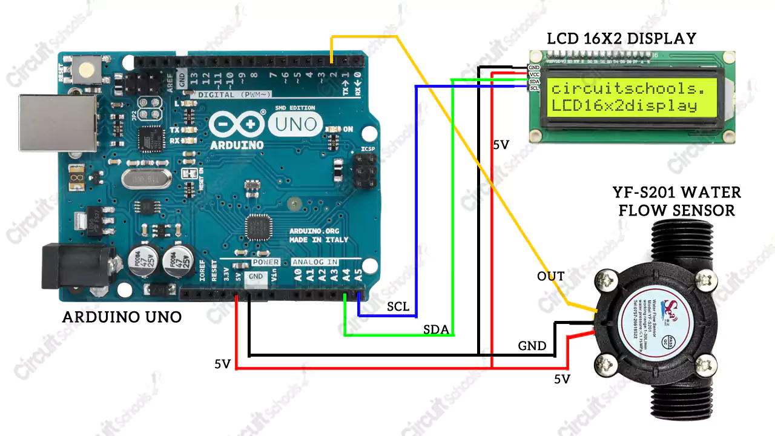
SYSTEM ARCHITECTURE

Slide 19
CONCLUSION
In conclusion, creating a water flow rate and overflow detection system with Arduino Uno is a significant advancement in environmental monitoring and safety. By combining electronics and sensors, this project offers an affordable solution for detecting leaks and preventing water wastage in homes and buildings.Using Arduino, along with a flow sensor and optional communication module, the system allows real-time monitoring of water flow rates and immediate leak detection. This empowers users to manage their water usage, prevent damage, and conserve resources effectively.Moreover, the project provides educational benefits in electronics and programming, benefiting both hobbyists and professionals. Overall, this system promotes sustainability and safety, making it a valuable addition to environmental stewardship efforts.

Slide 20
FUTURE ENHANCEMENTS
Enhanced Leak Detection Algorithms:
Implement more sophisticated algorithms to improve the accuracy and sensitivity of leak detection. This could involve machine learning techniques to analyze flow rate patterns and distinguish between normal usage and abnormal events more effectively.
Integration with Smart Home Systems:
Integrate the water flow rate and overflow detection system with existing smart home systems (e.g., Amazon Alexa, Google Home) for seamless control and monitoring. This allows users to receive alerts, adjust settings, and track water usage using voice commands or mobile apps.
Multi-Point Monitoring Capability:
Expand the system to support monitoring of multiple water outlets or zones within a property. This could involve deploying additional sensors at different points in the plumbing system to provide comprehensive coverage and insights into water usage patterns throughout the building.

Slide 21
REFERENCES
[1] Bhad Vidya, Kale Poonam, Gavhale Priyanka, Darekar Gaurav, A.S Chandgude, ”Water Level Monitoring System In Real Time Mode Using WSN”, International Journal of Emerging Technology and Advanced Engineering (ISSN 2250-2459, ISO 9001:2008 Certified Journal, Volume 6, Issue 9, September 2016.
[2] Mithila Barabde, Shruti Danve, “Real Time Water Quality Monitoring System”, International Journal of Innovative Research in Computer and Communication Engineering Vol. 3, Issue 6, June 2015.
[3] Jaytibhatt, jigneshpatoliya, ”IoT based water quality monitoring system”, International Journal Of Industrial Electronics And Electrical Engineering Volume-4, Issue-4, Apr. 2016.
[4] Behera, S. K., & Gupta, M. K. (2019). Implementation of IOT for energy management. Test Engineering and Management, 81(11-12), 4856-4860.

Slide 22
REFERENCES
[5] Cho Zin Myint, Lenin Gopal, and Yan Lin Aung, “Reconfigurable Smart Water Quality Monitoring System in IoT Environmet”, ACIS 16th International Conference on Computer and Information Science (ICIS), IEEE xplore, ISBN: 978-1-5090-5507-4.
[6] Anthony Faustine , Aloys N. Mvuma, Hector J. Mongi, Maria C. Gabriel, Albino J. Tenge, Samuel B. Kucel, “Wireless Sensor Networks for Water Quality Monitoring and Control within Lake Victoria Basin: Prototype Development”, Wireless Sensor Network, 2014, 6, 281-290.
[7] Goar, V. K., Tanwar, P., & Kuri, M. (2019). IoT based climate-smart agriculture. Test Engineering and Management, 81(11-12), 6620-6624.

Slide 23
REFERENCES
[8] Ali M. Sadeghioon, Nicole Metje, David N. Chapman and Carl J. Anthony, “SmartPipes: Smart Wireless Sensor Networks for Leak Detection in Water Pipelines”, Journal of Sensor and Actuator Networks ISSN 2224-2708.
[9]A EjahUmraeni Salam, Muh.Tola1, Mary Selintung and Farouk Maricar,” On-Line Monitoring System Of Water Leakage Detection In Pipe Networks With Artificial Intelligence”, ARPN Journal of Engineering and Applied Sciences VOL. 9, NO. 10, OCTOBER 2014.
[10] J.Navarajan, B. Aswinkumar, S. Venkatesh , T. Jayachandran, ”Detection of Water Pollution and Water Management Using Smart Sensors with IOT”, International Research Journal of Engineering and Technology (IRJET) Volume: 04 Issue: 04 | Apr 2017.

